Slide 1
Department of Infrastructure
The Language of Public Healthcare Architecture
Design Quality Oversight Practical 02 - Roof Systems
HEALTH INFRASTRUCTURE
Version 0.20250613

Slide 2


Design Quality Oversight – Framing the Technical Discussion and Practical 02
LEARNING MODE
COLLECTIVE COLLABORATIVE, INCLUSIVE LEARNING – PLEASE FEEL FREE TO CONTRIBUTE VERBALLY OR IN THE CHAT!!
TECHNICAL WORKSHOPPING DIALOGUE – WE IMPROVE DESIGN OVERSIGHT CAPACITY BY SHARING KNOWLEDGE
WORKING ON DOCUMENTATION EXAMPLES AND SHARPENNING THE ABILITY TO IDENTIFY DESIGN ISSUES
SHARING FROM LESSONS LEARNT IN DESIGN QUALITY OVERSIGHT
SHARING DESIGN OVERSIGHT FAILS FOR COLLECTIVE ACCESS TO LEARNING, MITIGATION AND PREVENTION IN THE FUTURE
INTERSECTIONALKNOWLEDGE INCLUSION
SCOPING THE TECHNICAL DISCUSSION
DESIGN QUALITY OVERSIGHT REQUIRES:-
A BUILDING SYSTEMS APPROACH – KNOW YOUR BUILDING TECHNICAL PARAMETERS, SYSTEMS AND COMPONENTS
KNOWLEDGE AND AWARENESS OF TYPICAL HEALTH INFRASTRUCTURE DESIGN RISKS AND IMPACTS
KNOWLEDGE OF DESIGN QUALITY PERFORMANCE METRICS
UNDERSTANDING OF DOCUMENTATION STANDARDS
UNDERSTANDING AND KNOWLEDGE OF LESSONS LEARNT
KNOWLEDGE OF NORMS AND STANDARDS, AND REGULATORY FRAMEWORK
KNOWLEDGE OF NATIONAL AND PROVINCIAL PERFORMANCE METRICS
KNOWLEDGE OF BUILDINGS, BUILDING MATERIALS, BUILDING TERMINOLOGY AND DETAILING
PRACTICAL SITE KNOWLEDGE
ABILITY TO FORECAST THE IMPLICATIONS OF A LINE OR A DETAIL IN THE PRACTICAL PROJECT ROLL – OUT PROCESS

Slide 3
Design Quality Oversight and Early Design Risk Identification
WHY IS CONTINUOUS DESIGN QUALITY OVERSIGHT IMPORTANT?
Design quality oversight plays a critical role in early identification of design risks.
Impacts and costs in time and money are reduced when design is rectified on paper, early in the planning stages.
Early identification and treatment of design risks
Prevention of design failures in facility operations
Prevention of design risks that pull through to construction
Reduction of design rectification costs downstream of the design process
Prevention on non – compliance and commissioning delays
Effective design risk mitigation
End User alignment
Improved health facility delivery
Design quality assurance through implementation and application of policies, norms and standards
Resolution of design matters in procurement (BSC – BEC - BAC), construction and operational stages is highly complex and costly. This must be prevented.
IN THE IMPLEMENTATION TEAM, OUR ROLE IS INFRASTRUCTURE DELIVERY OVERSIGHT, IN THIS CASE DESIGN QUALITY OVERSIGHT.
WHY?

Slide 4
Design Quality Oversight Approach – Roof Systems Case Studies and Dialogue
RESPONSIVENESS AND COMPETENCE – AN ACTION-BASED, SOLUTION - FOCUSED DESIGN QUALITY OVERSIGHT APPROACH?
Design quality oversight plays a critical role in early identification of design risks.
Impacts and costs in time and money are reduced when design is rectified on paper, early in the planning stages.
Latent / Static Knowledge
of Roofing Systems
Interpret and Adapt knowledge to implementation context
Actively Transfer Knowledge to implementation teams through DQO
Apply knowledge to identify risks and recommended actions
Collect Feedback, lessons learnt and Refine Knowledge
HOW?
Design Knowledge becomes dynamic, not when it is known, but when it is mobilised into Design Quality Oversight actions that yield improved design outcomes in healthcare facilities.

Slide 5

Design Quality Oversight – A Building Systems Approach _ Roof Systems
WORKING DEFINITIONS
A System Definition in the context of a health facility : A system is a set of interrelated components working together toward a functional objective.
The roof system in a health facility: A primary building envelope system that ensures shelter, water shedding, thermal regulation, and protection from environmental conditions.
In healthcare, it interfaces with other systems such as drainage, insulation, structural, fire protection, ventilation, medical gas, infection control, thermal regulation…...
Roof resilience: is the ability of a roof system to withstand, adapt to, and recover from environmental, structural, and operational stressors without compromising the function, safety, or continuity of healthcare services.
Water and moisture shedding refers to the roof system’s ability to divert rainwater, condensation, and ambient moisture away from the building envelope, preventing penetration, pooling, and retention that could compromise structural integrity, indoor health, and system performance.
Design Quality Oversight for roof systems: The structured process of reviewing, verifying, and guiding the design and detailing of roof systems to ensure they meet performance, safety, regulatory, and operational standards in line with the functional demands and pressures of public healthcare infrastructure context.
Purpose of Design Quality Oversight for roof systems: It is not merely checking technical details but upholding the integrity of the entire facility by ensuring the roof does not become a point of design failure.
We are ensuring the roof performs as a system which supports healthcare services and is designed with foresight, compliance, resilience and cost effectiveness.
Ensuring the facility roof is fit for purpose, preventing avoidable failures, alignment with norms and standards, climate responsiveness and effective integration into the overall facility system.

Slide 6
Design Quality Oversight – A Building Systems Approach _ Roof Systems
COMPONENTS OF A ROOF SYSTEM – WE CAN ONLY OVERSEE IF WE EFFECTIVELY UNDERSTAND WHAT WE ARE LOOKING FOR
AND HOW IT WORKS !! DEVELOPING “AN EYE” FOR ROOFING SYSTEM OVERSIGHT
Component | Definition
Roof Structure | Load-bearing framework (steel trusses/concrete slab) supporting the roof system
Roof Sheeting/Covering | Exterior barrier protecting interior from rain, heat, wind (e.g., sheeting, tiles)
Insulation/Underlay | Material layer improving thermal and acoustic comfort
Waterproofing Membrane | Sealant system preventing water ingress (important in flat/low-slope designs)
Gutters and Downpipes | Collection system for controlled removal of roof water
Flashing and Upstands | Edge/penetration detailing to prevent leaks
Roof Penetrations | Service entry points requiring waterproof treatment (e.g., ducts, vents)
Access and Safety Systems | Ladders, anchor points, catwalks for maintenance access and fall protection
Louvres and Louvre System | Passive climate control elements that support indoor environmental quality and mechanical ventilation performance.

Slide 7
Design Quality Oversight Approach – Roof Systems
RESPONSIVENESS AND COMPETENCE – AN ACTION-BASED, SOLUTION - FOCUSED DESIGN QUALITY OVERSIGHT APPROACH?
EXPECTATIONS FROM PSP TEAMS – ROOF SYSTEM
Submit coordinated roofing design rationale covering:
Material rationale
Build-up and insulation rationale
Drainage approach
Maintenance access plan
Asbestos and heritage compliance (if applicable)
Roof operational resilience strategy
Roof climatic and contextual resilience strategy
Water-shedding detail section at valleys, parapets, penetrations, and gutter interfaces as part of DQA review.
Documentation to expect
Full roof detail sections
Drainage schematics
OHS-compliance roof access drawings
Structural and climatic justification
Full wall sections indicating key design and resilience roof design rationale
OVERSIGHT FOCUS | ACTION – ADJECTIVES……
System Integration Review | Verify interface with structure, ceiling, drainage, and all services
Regulatory Compliance Check | Confirm adherence to SANS 10400, fire codes, and OHS access requirements
Material Suitability Assessment | Assess durability, climate fit, maintenance implications
Slope, Drainage, Detailing Review | Ensure water shedding is designed correctly and junctions are detailed
Load & Wind Uplift Verification | Check structural adequacy, especially for high-wind or coastal zones
Maintenance Access Provisions | Evaluate design for inspection hatches, walkways, anchor points
Heritage or Contextual Checks | Review material, form, and pitch against precinct context if applicable
QA of Drawings and Specifications | Detect omissions, misalignments, or insufficient detailing before issue

Slide 8
Resilient Roof Systems - Action – Based Early Design Risk Identification
ROOF DESIGN QUALITY OVERSIGHT RESPONSE – A PRACTICAL APPROACH TO DESIGN RISK IDENTIFICATION AND RESPONSE
01 - IDENTIFY THE THEMATIC DESIGN OVERSIGHT COMONENT | 02 – OBSERVE THE OVERSIGHT COMPONENT GAPS OR STATUS QUO | 03 – NAME AND PROJECT/ FORESEE THE POTENTIAL RISK | 04 – ACTION THE REQUIRED DESIGHT QUALITY OVERSIGHT AND EARLY DESIGN RISK PREVENTION RESPONSE
Drainage Capacity & Flow | Box gutters undersized; no overflow routes | Storm flooding, ceiling leaks, structural failure | Provide rainfall sizing calculations, overflow detailing, gutter sizing
Roof-to-Stormwater Integration | Roof discharge not linked to site drainage or reuse systems | Surface flooding, water pooling near entrances | Submit schematic showing flow to attenuation/municipal system
Service Penetrations | No sealing or flashing detail for ducts and vents | Water ingress, damp damage | Provide coordinated roof penetrations with flashing and upstands
Thermal Performance | No insulation under metal sheeting over occupied spaces | Overheating, patient discomfort | Include insulation (50mm+) or radiant barrier; submit U-value calculation
Safe Maintenance Access | Plantroom roof lacks access route or fall protection | OHS risk, future maintenance failure | Add walkway plan, harness points, and signage layout

Slide 9
Resilient Roof Systems - Action – Based Early Design Risk Identification
ROOF DESIGN QUALITY OVERSIGHT RESPONSE – A PRACTICAL APPROACH TO DESIGN RISK IDENTIFICATION AND RESPONSE
01 - IDENTIFY THE THEMATIC DESIGN OVERSIGHT COMONENT | 02 – OBSERVE THE OVERSIGHT COMPONENT GAPS OR STATUS QUO | 03 – NAME AND PROJECT/ FORESEE THE POTENTIAL RISK | 04 – ACTION THE REQUIRED DESIGHT QUALITY OVERSIGHT AND EARLY DESIGN RISK PREVENTION RESPONSE
Local Repairability | Non-standard membrane or imported roofing specified for rural project | Replacement delays, lifecycle cost risk | Replace with locally supported or maintainable materials
Noise Control | Lightweight roof over ICU or mental health unit with no sound attenuation | Patient discomfort, clinical quality impact | Add acoustic insulation and isolation ceilings
Structural Load Confirmation | Rooftop PV system shown with no structural verification | Truss deflection, slab stress | Submit structural engineer's design with full load factors
Asbestos Consideration | Old roof in renovation project with no asbestos status disclosed | Legal breach, health risk to workers and occupants | Commission asbestos survey and include abatement/removal plan
Build-up & Detail Clarity | Roof build-up missing insulation, waterproofing, slope direction | On-site misinterpretation, non-performance | Submit full section drawing for all roof types
Solar Shading | No shading or overhangs on east/west façades | Solar gain, HVAC overload | Design integrated shading (eaves, fins, roof extensions)

Slide 10
Resilience of Roofing Systems in the Public Healthcare Architecture Context
RESILIENCE AND MAINTENANCE CONSIDERATIONS FOR ROOF DESIGN OVERSIGHT – WHAT TO CONSIDER DURING OVERSIGHT
Dimension | Oversight Expectation
Material Lifespan | 20+ year durability, tested for climate and UV exposure
Local Repairability | Use materials serviceable with regional tools and contractors
Access and Maintenance Zoning | Include walkways, anchor points, and safe service routes
Drainage Redundancy | Add overflow spouts, scuppers, and rainwater diversion safeguards
Passive Cooling Contribution | Incorporate insulation and reflective coatings where HVAC loads are high
Modular Component Design | Enable partial repair (e.g., replace damaged sheeting without removing full roof section)
Safety Integration | Fall arrest and OHS signage permanently installed
Installation Oversight | Quality of installation and compliance with installation spec
Micro – Climatic Adaptation | Effectiveness and rationalization of adaptation to micro – climatic adaptations

Slide 11
Resilience of Roofing Systems in the Public Healthcare Architecture Context
RESILIENCE AND MAINTENANCE CONSIDERATIONS FOR ROOF DESIGN OVERSIGHT – WHAT TO CONSIDER DURING OVERSIGHT
DIMENSION | EXPLANATION
Structural Integrity | Capacity to resist wind uplift, impact, and loads without failure or deformation.
Climatic Adaptation | Performance under heat, rain, hail, or coastal salt exposure based on location.
Waterproofing Durability | Ability to maintain watertightness over time, preventing leaks and microbial risk.
Material Longevity | Resistance to corrosion, UV damage, and biological degradation (e.g. moss, rot).
Maintenance Accessibility | Safe and structured access for inspections, repairs, and preventative upkeep.
Fire and Safety Performance | Use of non-combustible materials and fire-rated assemblies.
Redundancy and Recovery | Backup drainage, modular repairs, and minimal service disruption during failure.

Slide 12
Design Quality Oversight – Special Considerations for Roof Systems
ROOF DESIGN QUALITY OVERSIGHT RESPONSE – HERITAGE BUILDINGS | ASBESTOS
ASBESTOS ROOF SYSTEM CONSIDERATIONS
Asbestos survey must be performed and submitted
If confirmed: abatement plan, staff/public protection strategy, and certified contractor involvement are mandatory
No demolition or cutting of roofing may proceed without clearance
HERITAGE ROOF SYSTEM CONSIDERATIONS | HERITAGE ROOF DESIGN OVERSIGHT REQUIREMENT
Roof Profile & Pitch | Respect historic ridgeline and silhouette
Material Compatibility | Avoid highly reflective or non-traditional materials in visible zones
Rainwater Goods | Use concealed or heritage-matching profiles
Mechanical Visibility | Recess rooftop plant below visual threshold
Regulatory Process | Submit heritage impact visuals and approval from Provincial/National authorities

Slide 13
Design Quality Oversight – Roof Systems Oversight Focus Per Project Category
ROOF DESIGN QUALITY OVERSIGHT RESPONSE – PRIORITISATION AND FOCUS BY PROJECT CONTEXT
PROJECT CATEGORY | DESIGN OVERSIGHT APPROACH | ROOFING PRIORITIES | OVERSIGHT FOCUS
R&R / MAINTENANCE | Assess existing structure and ensure the application of relevant design interventions | Asbestos mitigation, safe access, like-for-like continuity | Phased roof work plan, compliance with OHS & Asbestos regulations
NEW PRIMARY HEALTH CARE BUILD | Lightweight sheet roof with thermal/acoustic control and gutters | Patient comfort, quick install, cost control | Roof-to-drainage linkage, insulation detailing, flashing
NEW HOSPITAL/MULTI-STOREY | Flat slab or hybrid roof with plant access in the context of cost effectiveness and user client preferences | Structural integrity, redundancy, service integration | Slab detailing, plant access, water discharge redundancy
SPECIALISED FACILITY (E.G. ICU, APU, LAB) | Air-tight and acoustically sealed roof with strict HVAC penetration control | Infection control, sound, fire rating | Material performance, penetration treatment, isolation zoning

Slide 14
Design Quality Oversight – Roof Systems Regulatory Framework
OVERSEEING THE APPLICATION OF ROOF REGULATORY AND CONTEXTUAL FRAMEWORK IN THE DESIGN OVERSIGHT PROCESS
Reference | Application
SANS 10400-L | Roof design and water discharge compliance
SANS 204 | Energy efficiency and thermal control
SANS 10214 | Safe access and fall protection on roofs
OHS Act | Maintenance and access safety regulations
Asbestos Abatement Regulations (2020) | Management and removal of asbestos materials
National Core Standards | Functional and safe healthcare environment
NDOH IUSS Guidelines | Healthcare infrastructure design alignment
NHRA (Act 25 of 1999) | Heritage structure modification approvals
Local climatic data | Rainfall and wind loading calculations

Slide 15
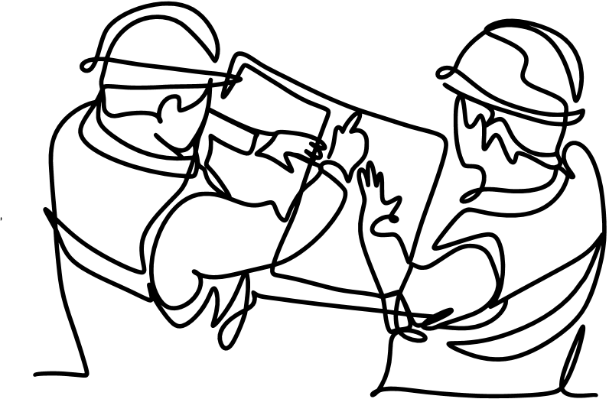
Design Quality Oversight - Design Oversight Practical 02
CASE STUDY 01
MITCHELLS PLAIN HOSPITAL ROOF REPORT
A Multi – Disciplinary practical evaluation of existing roof systems and insights for application in the design oversight process.
PRACTICAL APPLICATION AND LESSONS LEARNT!!!!

Slide 16
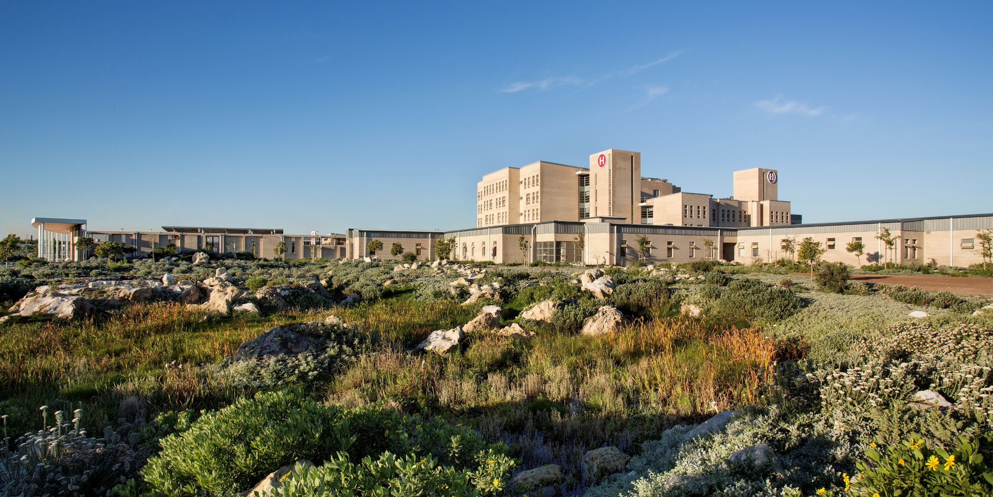
Case Study 1
Mitchell’s Plain Hospital: Roof Leaks Preliminary Inspections
12 December 2024 and 12 February 2025: Dry season
Waldo Newman: Production Civil/Structural Engineer
Cornelia McEnery-Hayes: Chief Architect
Aashieka Jabaar: Control Works Inspector
Bulelwa Nontolwana: Chief Works - Inspector
Nazeem Hermans: Artisan Chief MPH

Slide 17
Mitchell’s Plain Hospital
Final completion: 24 July 2014
Latent defect period expired: 23 July 2024
Infrastructure failure issues rectified by WCDHW Engineering contractor in 2024
Water proofing on flat roofs.
Cleaning & installing new full bores.
Skylight waterproofing.
Lighting & ceiling at Emergency Centre.
Front door servicing at Emergency Centre.
Bumper rails covering.
Vinyl in patches.
Window servicing.
Painting & servicing of doors
Aluminium Gutters.

Slide 18
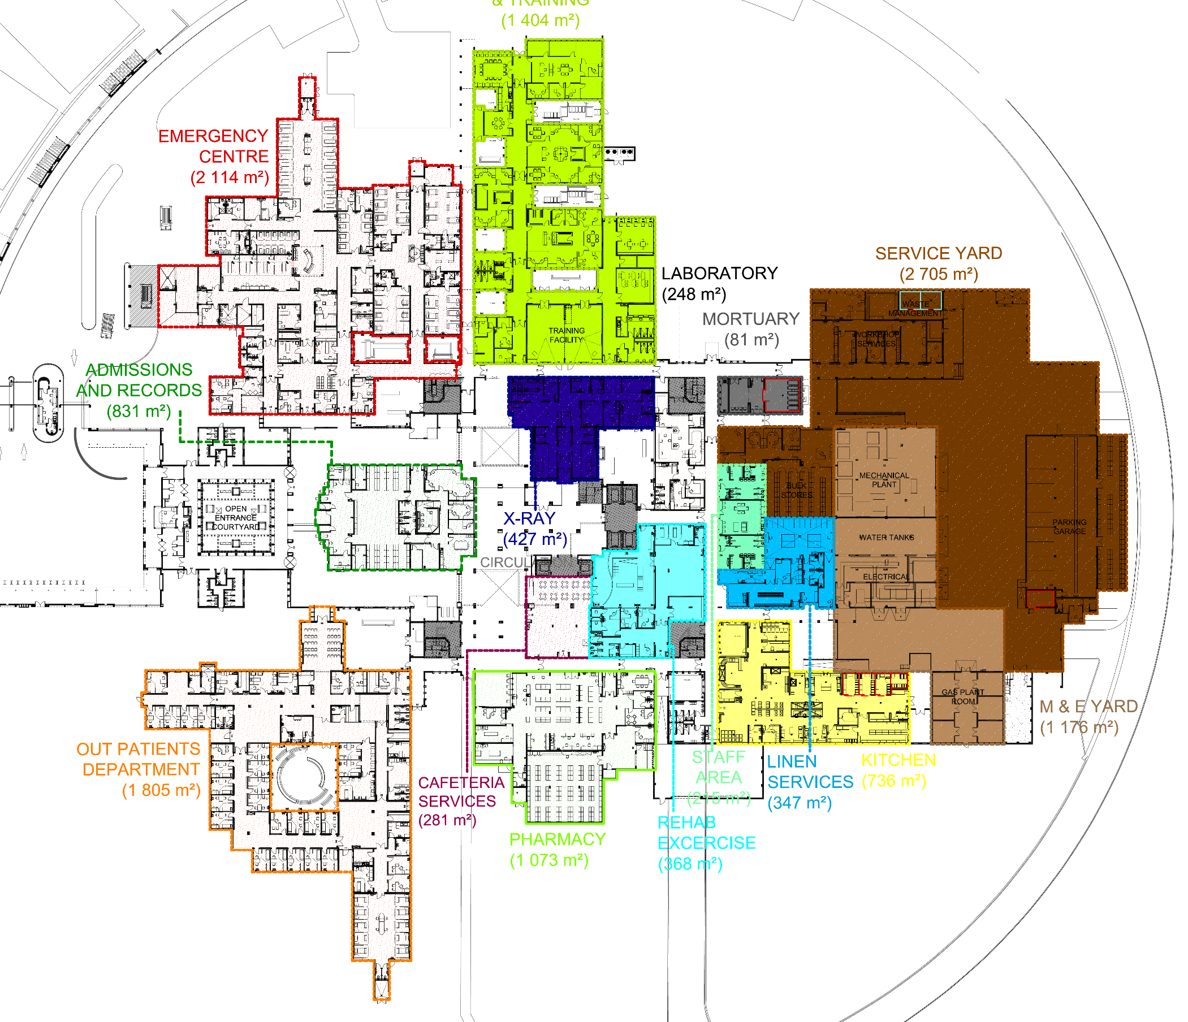
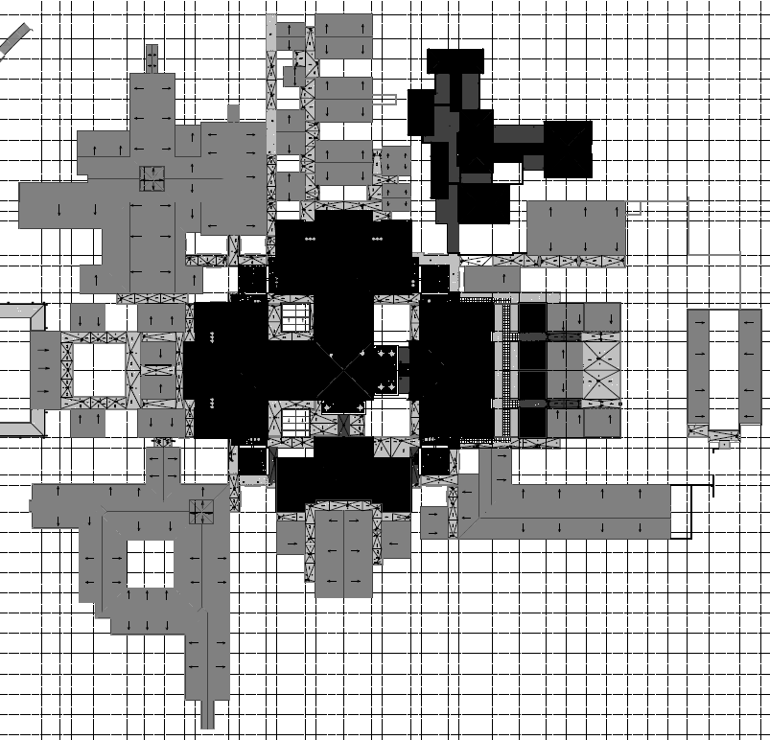
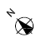
Mitchell’s Plain Hospital
Further roof leaks reported
Emergency Centre
2
1
Admin
Hospital Main Entrance
Rehab
3

Slide 19

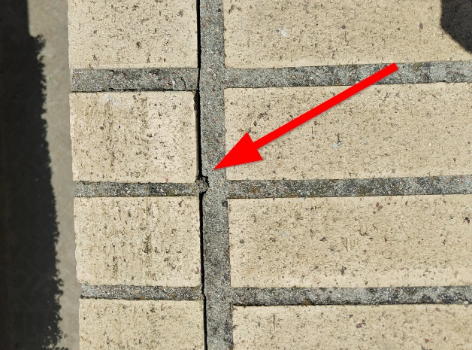
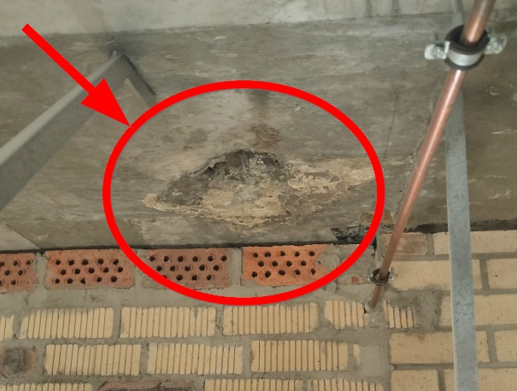
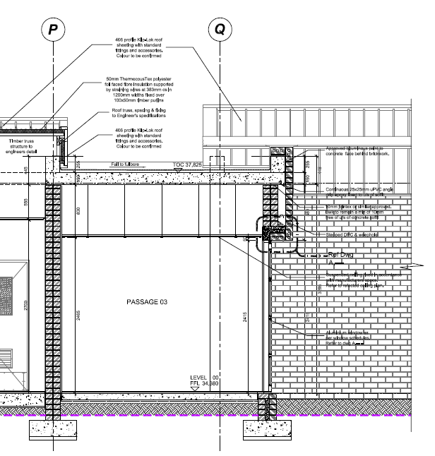
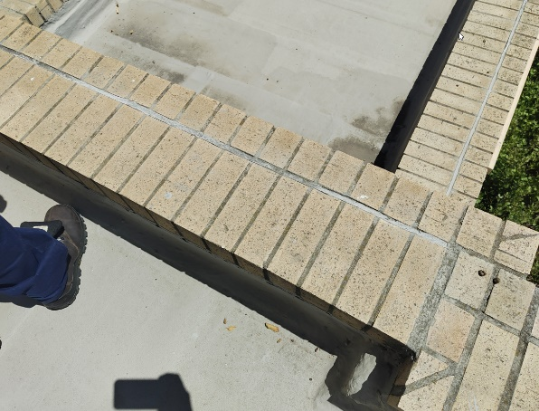
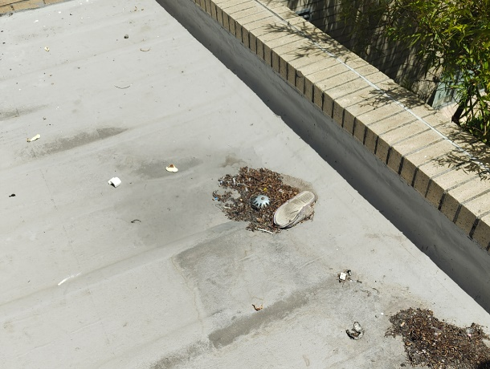
Mitchell’s Plain Hospital
FINDINGS
Area 1: Admin
Flat roofs & Parapets
Flat parapet walls, not sloped coping / no drip edge
Mortar cracking parapet walls
Fullbores obstructed, No leaf/debris cages
Limited overflow
Surface discolouration ponding of water
Damage to concrete soffit (not structural)
Omission of stone chips reduces UV resistance
Cracks within Mortar on Parapet Walls
Damage to underside of RC roof slab
Flat and wide parapet walls prolonging water retention
Debris accumulation on flat roofs

Slide 20
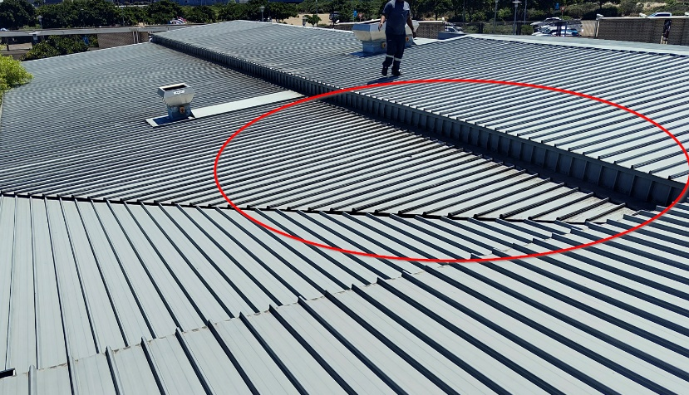
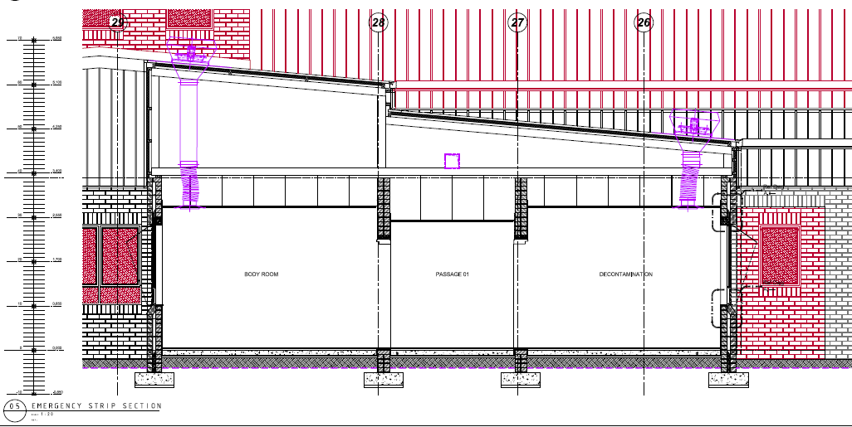
Mitchell’s Plain Hospital
FINDINGS
Area 2: Emergency Centre
Pitched roofs
EC resus area leak:
Roof pitch 5 ° flat slope: pooling of water
Force from wind-driven rain risk
Roof penetration leak risks
Omission of gutter
Klip-Lok 406 roof sheeting good condition
Flat slope and step in roof providing area for water accumulation
Gutter was removed/omitted and should be reinstated

Slide 21
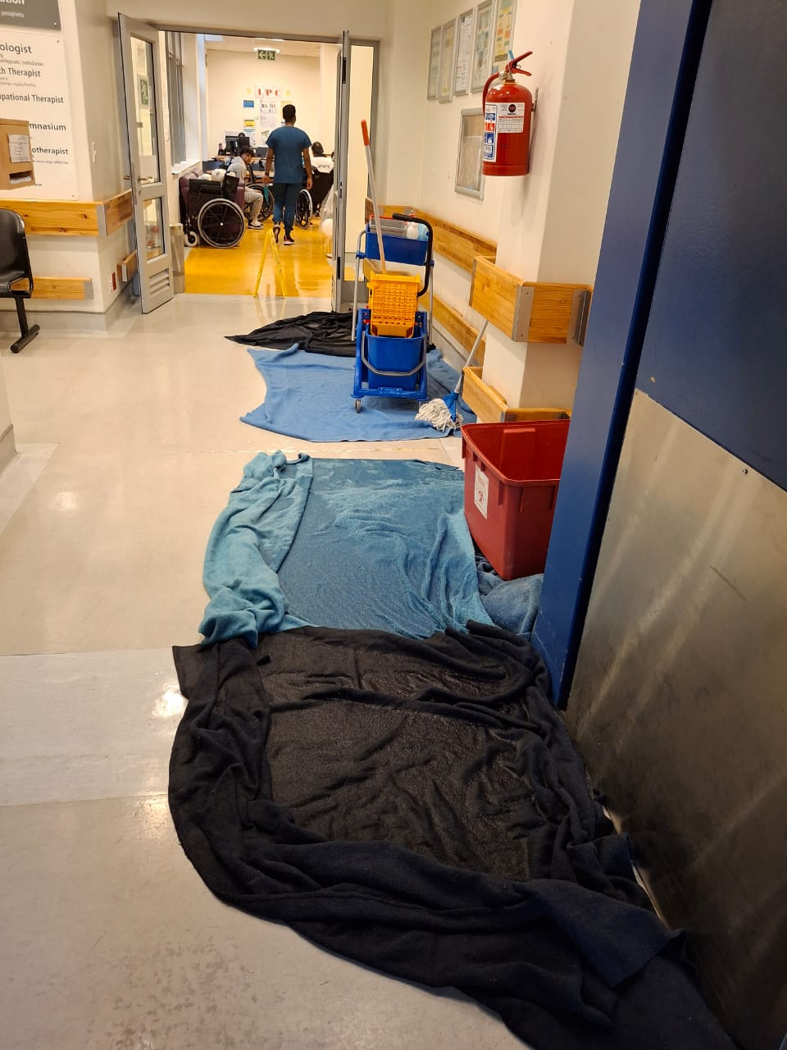
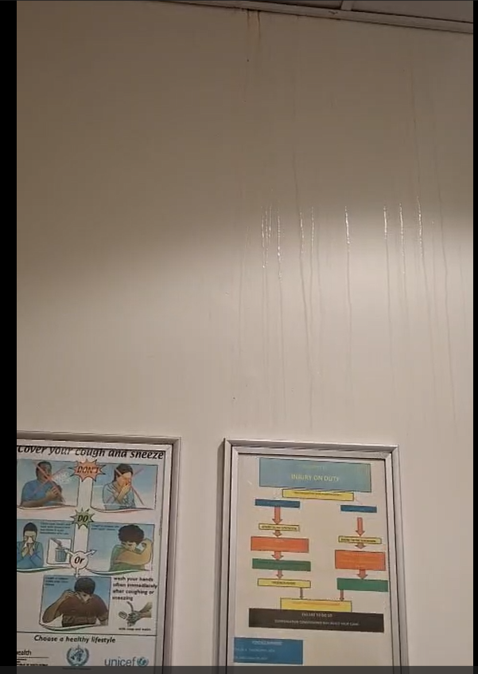
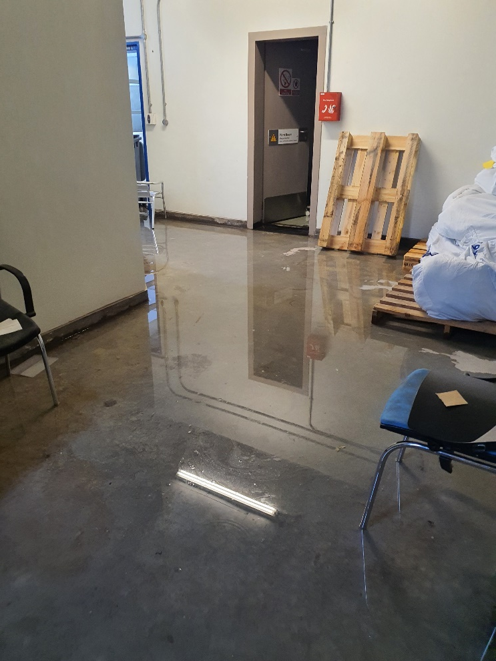
Mitchell’s Plain Hospital
Area 3: Rehabilitation and Plant Room
Water ingress into second floor Stair Lobbies & Plant rooms and ground floor Rehabilitation Department Waiting Area below
Ground Floor
Water leaks along nw wall rehab waiting
First Floor
Stair lobby & Plant Room

Slide 22
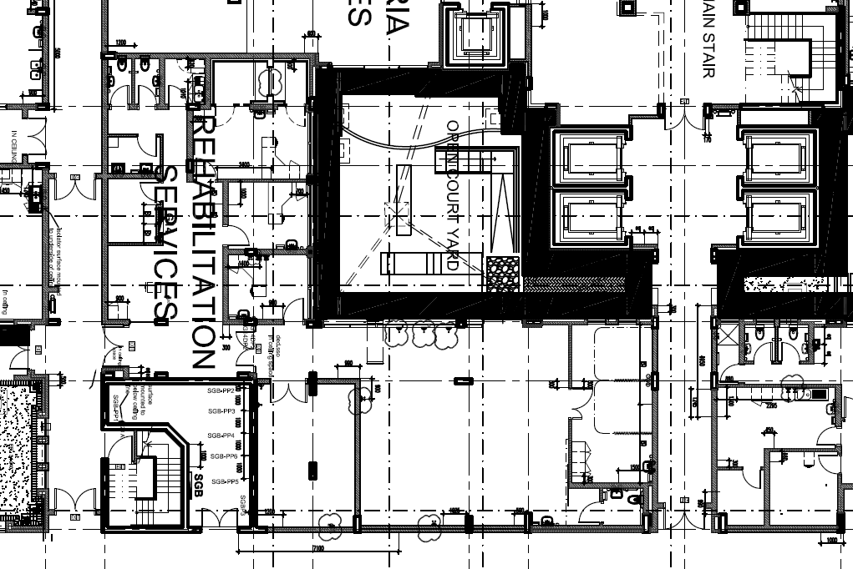
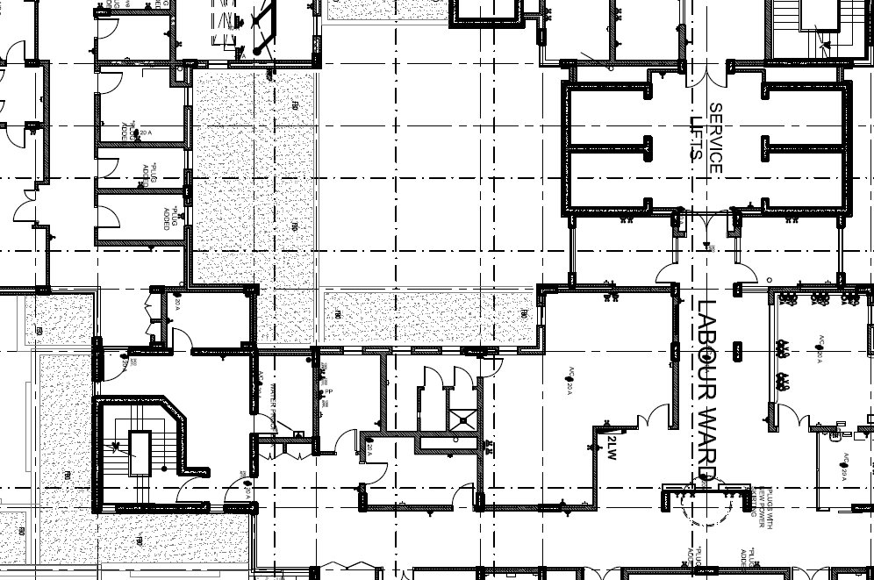
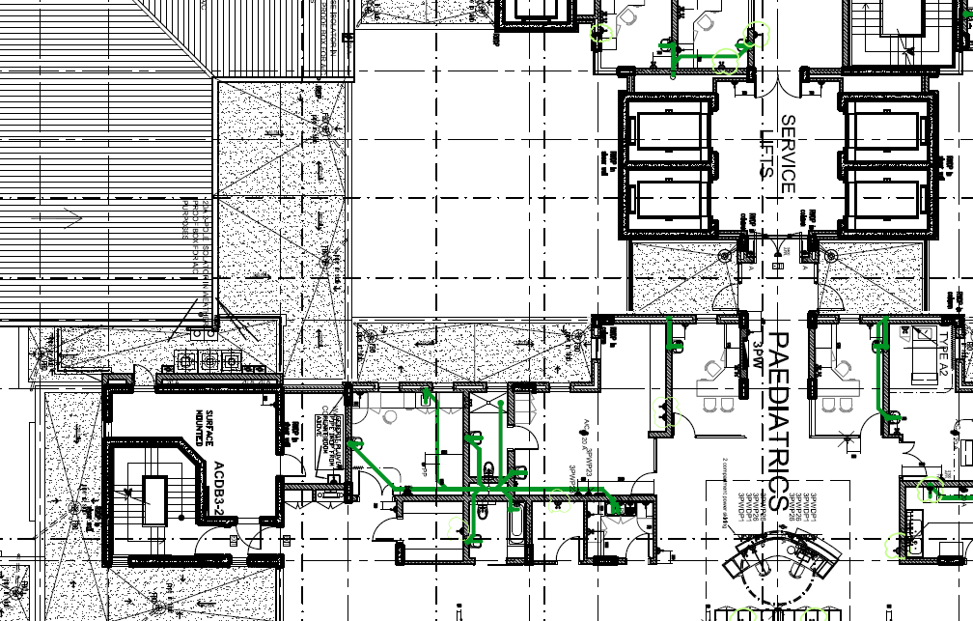
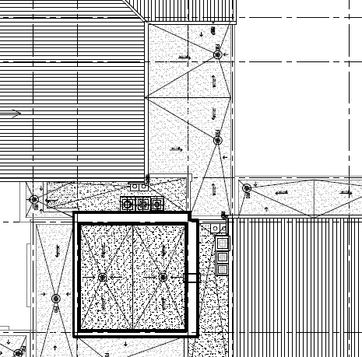

Mitchell’s Plain Hospital
Area 3: Rehabilitation and Plant Room
Rehab Waiting
Plant rm
Balcony
Ground Floor
Water leaks along nw wall rehab waiting
Second Floor
Plant room: Structural Cracks
Third Floor
Balcony Cavity Wall
Weepholes
NW facing
Tower Roof Level
Cavity wall roof closer

Slide 23
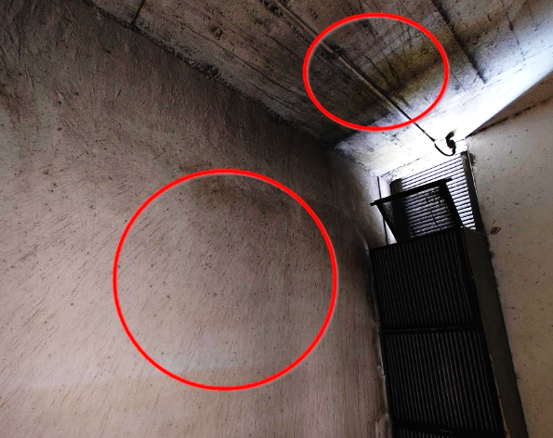
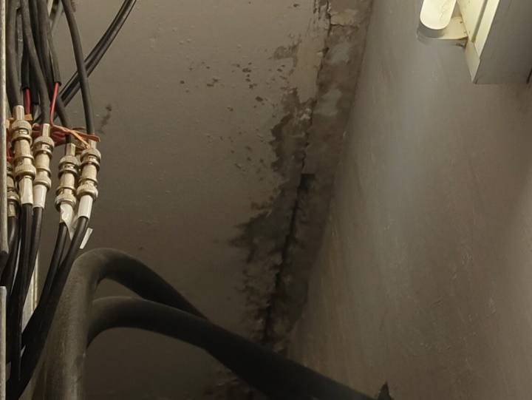
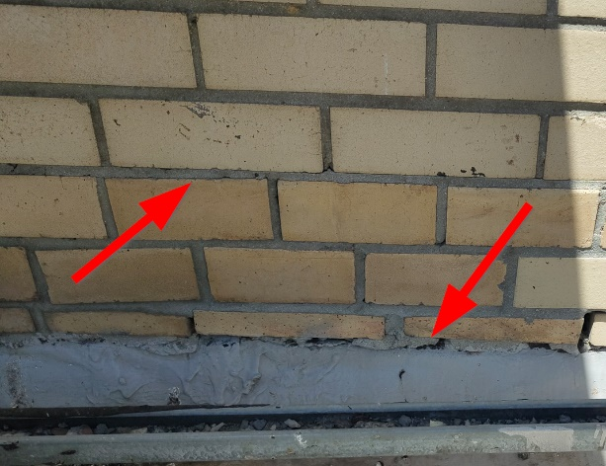
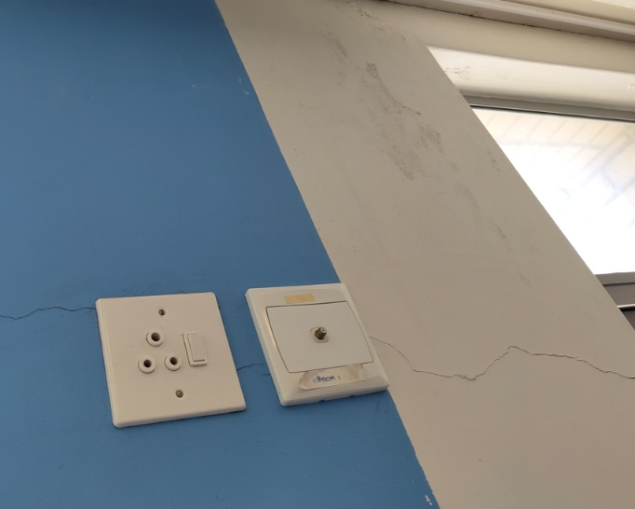
Mitchell’s Plain Hospital
FINDINGS
Area 3: Plant room and Rehabilitation
Second Floor Structural Cracks
Plant room: significant soffit & column cracks
Remainder cracks minor movement cracks not structural concern
Water ingress via the louvre
Third Floor: indication of water ingress through louvres
Second Floor: Significant cracking within plantroom
Third Floor: Horizontal cracks and separation in mortar
Minor cracks which may contribute towards moisture ingress

Slide 24
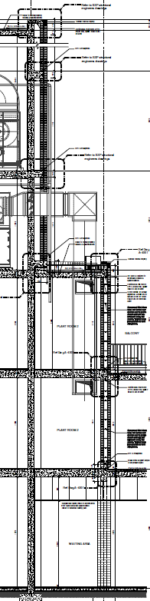
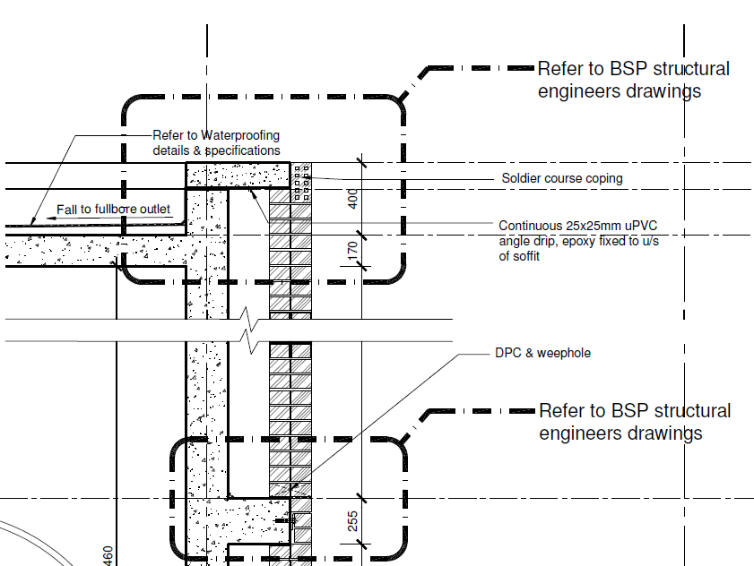
Mitchell’s Plain Hospital
Tower Roof Level
Tower Roof Level
Potential water ingress
Cavity closer at parapet level not sloped
Cracking of mortar as evident elsewhere
Cavity not draining, weepholes not fully functional
Balcony
Third Floor
Plant Room
Second Floor
Rehab Waiting
Ground Floor

Slide 25
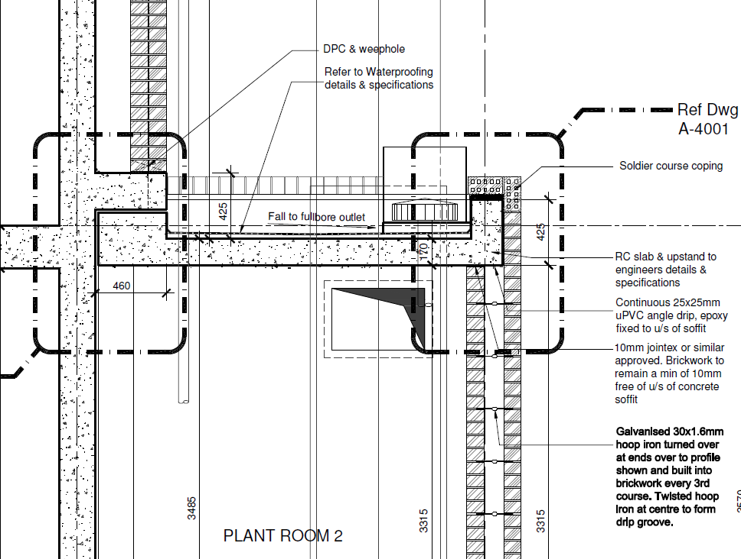
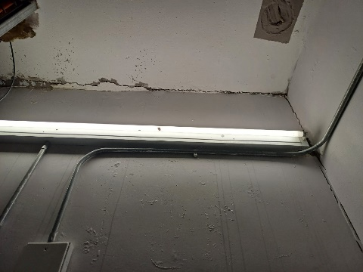
Mitchell’s Plain Hospital
Second Floor Plant Room & Third Floor Balcony
Tower Roof Level
Balcony
Balcony
Third Floor
Structural crack
Plant Room
Second Floor
Plant Room
Rehab Waiting
Ground Floor

Slide 26
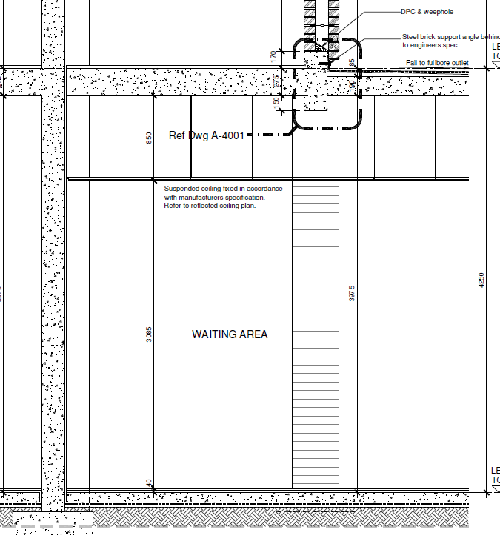
Mitchell’s Plain Hospital
Ground Floor
Tower Roof Level
Balcony
Third Floor
Plant Room
Second Floor
Rehab Waiting
Ground Floor

Slide 27
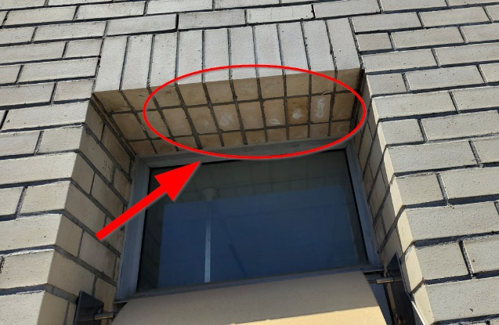
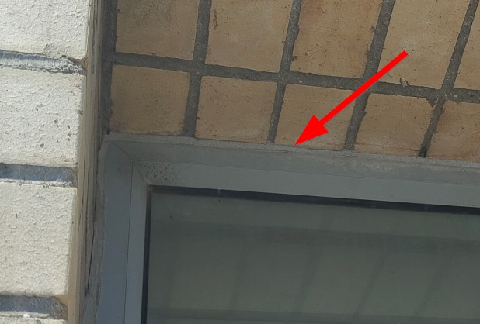
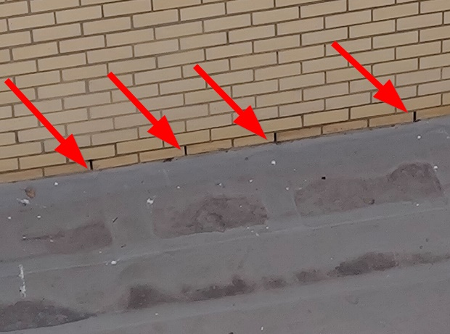
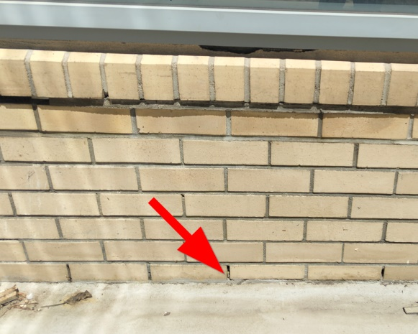
Mitchell’s Plain Hospital
FINDINGS
External Brickwork
Efflorescence visible
Wide, flat external window sills and top-reveals causing water pooling and penetration
Minor cracks in horizontal mortar joints
Weep holes blocked/missing
Weep holes positioned too low (directly above suspended slabs), allowing standing water to re-enter
No weephole covers (wind-driven rain penetration)
Seals around windows failing
Water residue on wide, flat window reveals
Seals around windows which are potentially problematic in some areas
Weep holes directly on roof slabs
Minor cracks which may contribute towards moisture ingress

Slide 28
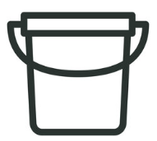
Mitchell’s Plain Hospital
FACTORS CONTRIBUTING TO MOISTURE INGRESS
Design deficiencies of certain elements – evident within the flat and wide parapet walls and window reveals, the stepped and relatively flat-sloped roof, as well as the selection of louvres installed within the building.
Poor workmanship during construction – evident within the cracks in the mortar joints on parapet walls and vertical walls, cracked seals around windows, and low level of weep holes.
Maintenance oversights –accumulation of debris on roof slabs and blocked fullbores.

Slide 29

Mitchell’s Plain Hospital
RECOMMENDATIONS FOR MITCHELL’S PLAIN HOSPITAL
It remains a challenge to determine the degree to which each of the defects contributes towards the water ingress.
Additional site visit during a rainstorm as this may provide further insights.
Leak detector test especially for the EC resus area.
Structural cracks plant room: further investigation to determine the risk
Carry out remedial works
Improved maintenance regime

Slide 30

Mitchell’s Plain Hospital
LESSONS LEARNT
ROOF CONSIDERATIONS
Avoid low-pitched roof sheeting designs
Roof design to be compliant with SANS 10400-L (2020):
Slope of valleys in roofs with hips and valleys shall not be less than 11°.
Recommendation: minimum 11° pitch for metal roof sheeting roofs. (avoid pooling)
Consider the orientation of roofs and wind-driven rain.
Avoid ‘nook and crannies’ especially on wind-driven rain prone facades.
Where possible avoid penetrations into roof sheeting, and if absolutely necessary, ensure adequate waterproofing systems are installed to avoid leaks at the weak points. The waterproofing installations to be inspected for deterioration by maintenance team on a yearly basis.

Slide 31
Mitchell’s Plain Hospital
LESSONS LEARNT
WALLS & PARAPETS
Ensure compliance to inter alia SANS 10400-K (2015), SANS 2001-CM1 (2012)
Parapet walls to be adequately waterproofed with DPC/waterproof membrane below coping. Coping to have overhang and drip grooves. Copings to be sloped (5° minimum) or sloped bricks for water run-off.
Avoid positioning weepholes directly at balcony levels, to avoid pooled water or driving rain entering back into weepholes.
Inspections are required during construction to ensure cavities of cavity walls are clean from debris.
Mortar: Continuous quality assurance is required during construction mortar to adhere to standards, such as composition and prescribed period of use, to avoid mortar cracking.

Slide 32
Mitchell’s Plain Hospital
LESSONS LEARNT
WEATHER LOUVRES (Refer to: WCGI GTS-HVACSS: Louvre specification under development)
Consider the system to support the louvre performance: waterproofing, sub-frame and drainage systems
Location of plant rooms and louvres and driving rain risks
Extruded aluminium sections or ferrous metal hot dip galvanised after manufacture, as specified.
Finished in natural anodised aluminium, powder coated or painted is specified.
Constructed with drip edges to blades and rigid frame to enable building in.
Watertight even with nominal air velocity up to 3,0m/s.
Fitted with 12mm opening size galvanised expanded metal or wire mesh screen.
Top and bottom blades shall be fitted flush with the frame and smooth without grooves, channels or recess where dirt or water can collect.
Sufficient seals around frame
AS-BUILT DOCUMENTATION
Ensure all drawings, designs, specifications are accurate and digitally available for future use

Slide 33
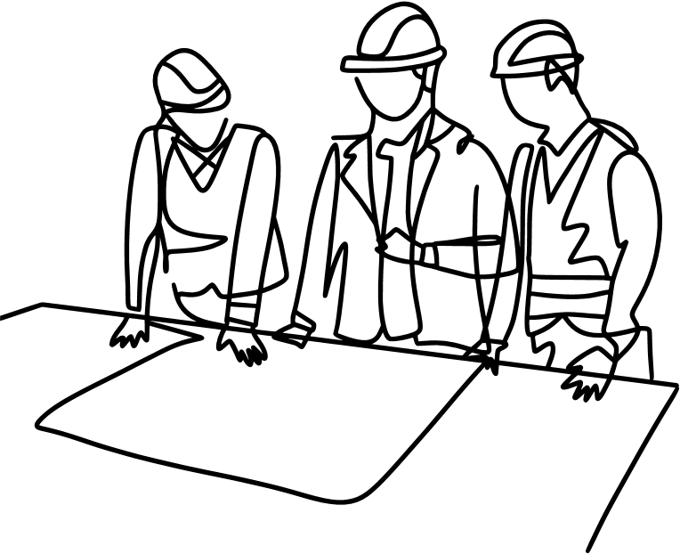
Design Quality Oversight - Design Oversight Practical 02
CASE STUDY 02
KHAYELITSHA HOSPITAL ROOF REPORT
A Multi – Disciplinary practical evaluation of existing roof systems and insights for application in the design oversight process.
PRACTICAL APPLICATION AND LESSONS LEARNT !!!!

Slide 34
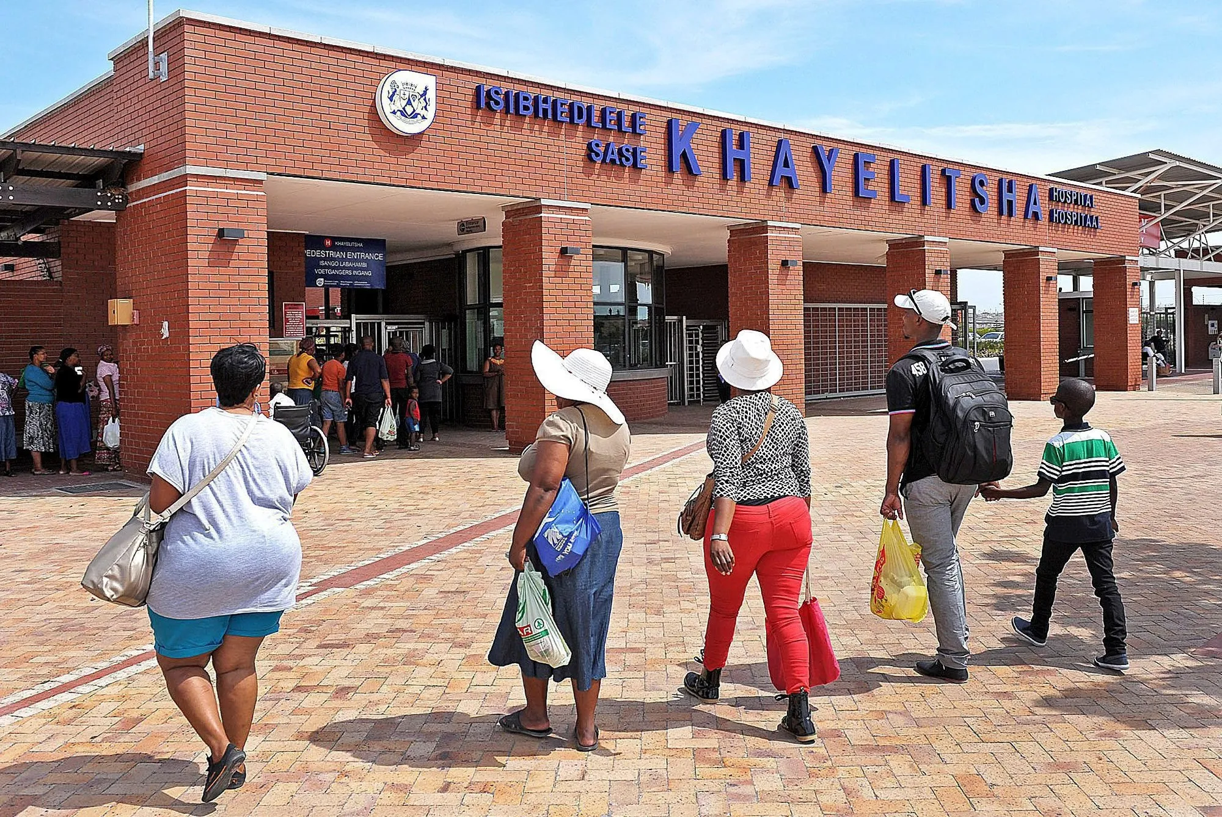
Case Study 2
Khayelitsha Hospital:
Roof Leaks Preliminary Inspection
16 April 2025: Autumn season
Waldo Newman: Production Civil/Structural Engineer
Cornelia McEnery-Hayes: Chief Architect
Mandla Nyoni: Production Architect
Siyanda Khohli: Industrial Technician: WCDHW Engineering
Charles Boyce: Artisan: Khayelitsha Hospital
Marcellus Finlayson: Scheltema
Girshwan Bredenkamp: Scheltema
Craig Uys: Global Roofing Systems

Slide 35
Khayelitsha Hospital
Final completion: 6 December 2012
Latent defect period expired: 5 December 2022
Certificate of Completion indicated a 5-year latent defect period, the JBCC Contract indicated a 10-year latent defect period.
Contractor G5: Subcontractor Scheltema & Co (Pty) Ltd
Roof sheeting installed: 0.58mm Z275 Kliplok 406
Roof sheeting: 5-year extended guarantee from 29 September 2011 to 28 September 2016.
Latent defects reported including ceiling damage, site inspection February 2016.
Identified roof leaks and corrosion to the roof sheeting.
Defects: dents to sheeting, loose sheets, damage to poorly installed ridge cappings and roof flashings.
Scheltema roof repairs: September 2016. The extent of the subcontractor’s repairs is unconfirmed.
During this time, the Hospital had engaged a separate contractor to undertake remedial work under their maintenance budget, who undertook repairs to the roofs as well.
‘Pap- en-Lap’ repairs to the roof apron detail were undertaken by the Hospital’s contractor.
Site inspection 2025: latent defect repairs not declared by the subcontractor
Subcontractor not forthcoming in providing details on the installation or reasons for failures.

Slide 36
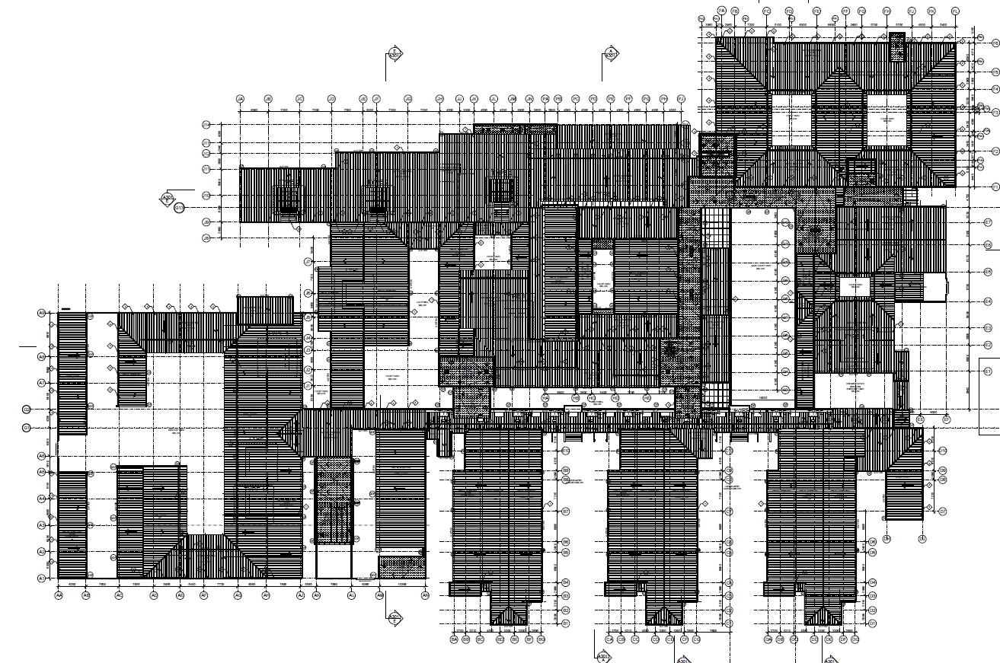
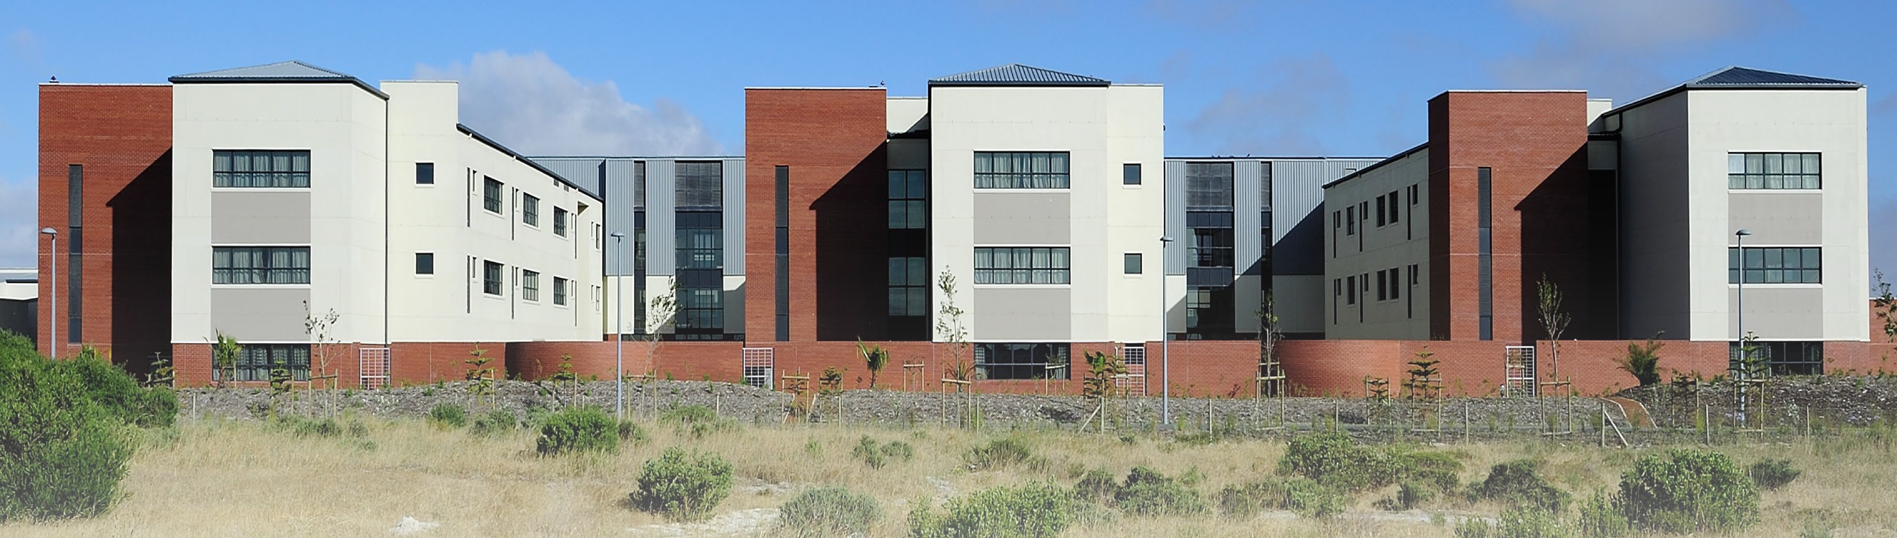
Khayelitsha Hospital
Hospital Main Entrance
Paediatric Ward
Medical 1 Ward
Medical 2 Ward

Slide 37
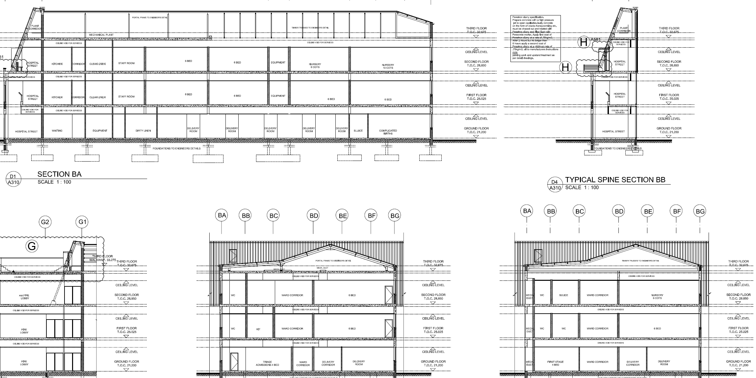
Khayelitsha Hospital
Galvanised Steel Portal Frames
Timber trusses
Paediatric Ward
Paediatric Ward

Slide 38
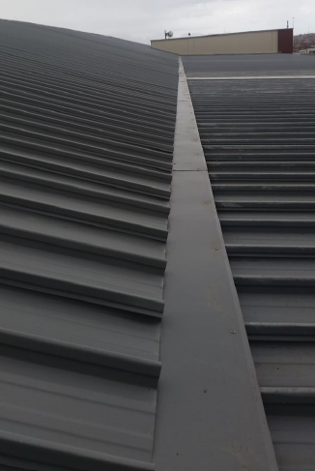
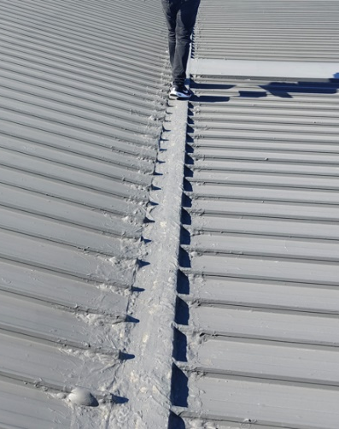
Khayelitsha Hospital
FINDINGS
1. Roof pitch transition detail
Roof pitch transitions from 21° to 3° slope
Flat slope of 3°: wind-driven rain ingress
Joint sealed ‘Lap-en-Pap’ liquid membrane sealant
Apron detail and ‘lap-en-pap’: ineffective promote water accumulation,
Resulting in severe sheeting corrosion and water ingress
Overview of transition detail from above (photograph taken in 2016)
Overview of transition detail from above (photograph taken in 2025)

Slide 39
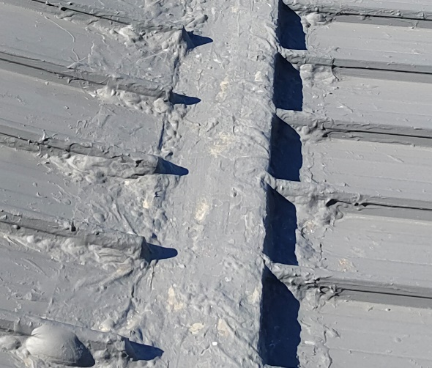
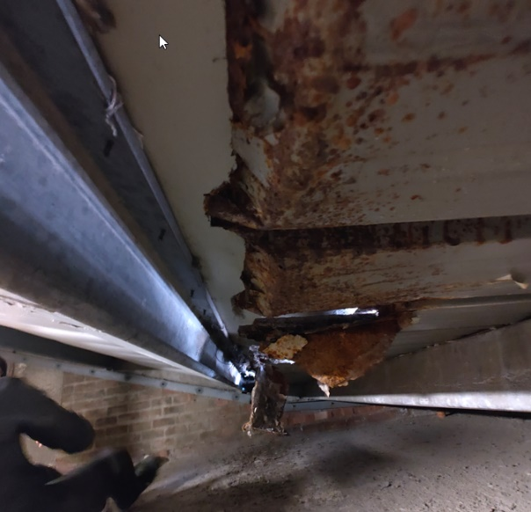
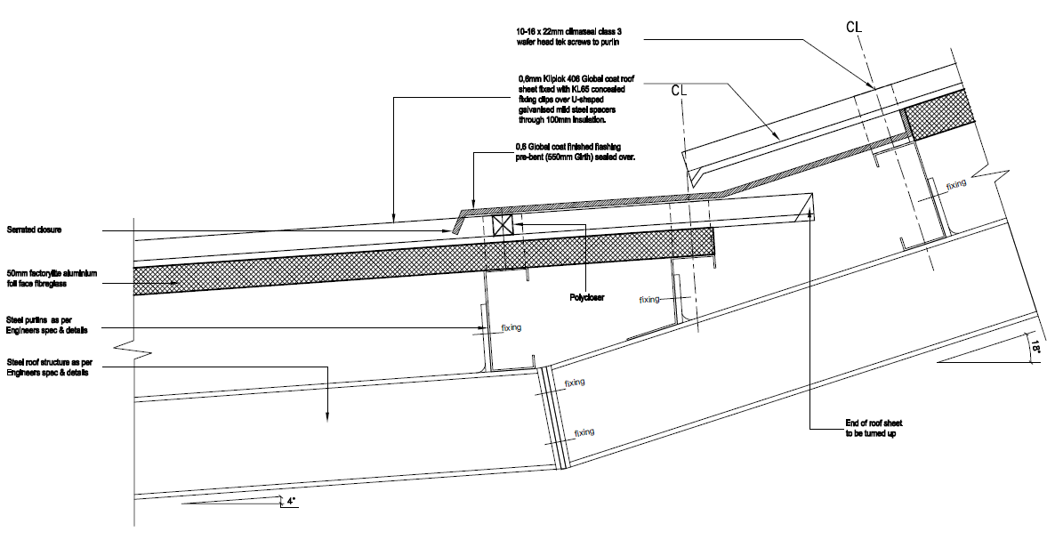
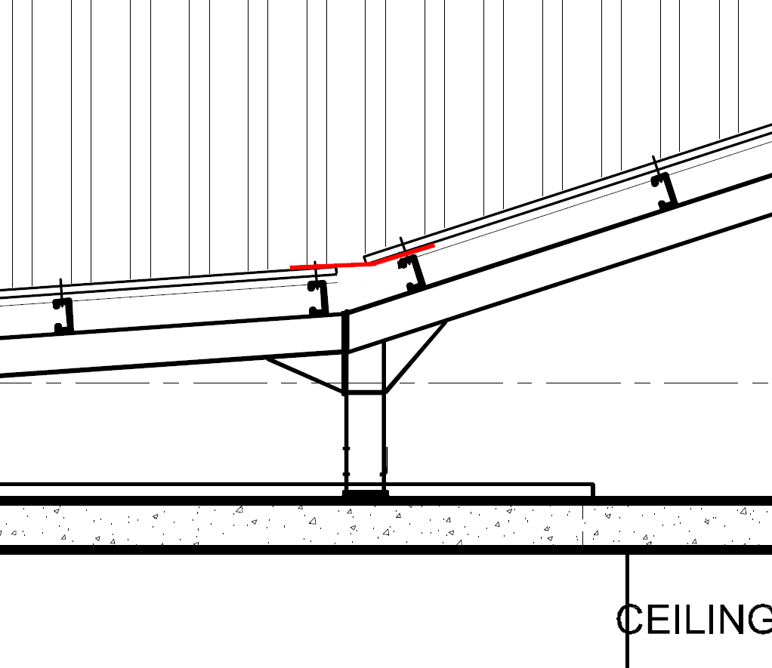
Khayelitsha Hospital
FINDINGS
1. Roof pitch transition detail
Inadequate overlap of upper sheet over lower sheet/flashing, to be at least 150-200mm.
*Bimetallic corrosion suspected, subcontractor confirmed after the April 2025 site inspection that all the flashings were manufactured from the same material as the sheeting.
Sheet edges bent upward
On-site cutting suspected
Close-up of transition, with “lap-en-pap” clearly visible
Underside of transition detail, with severe corrosion clearly visible
Apron flashing detail @ cranked roof junction for Khayelitsha hospital
*Representation of observed transition detail. Note the flashing in contact with the roof sheets

Slide 40
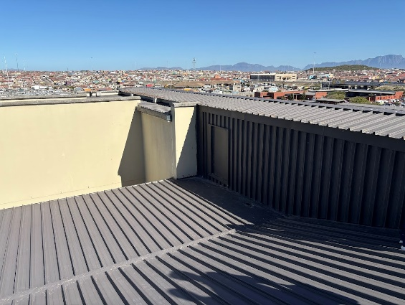
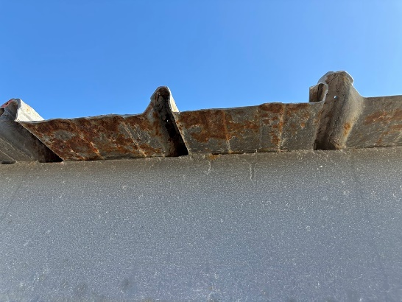
Khayelitsha Hospital
FINDINGS
2. Corrosion to roof sheeting
Underside of roof sheeting:
Advanced material degradation
Visible surface rusting
Flaking of the protective coating Globalcoat finish
Signs of base metal perforation, rust staining and pitting of the steel base
Localised perforation and material failure at insulation contact points
Corrosion to roof sheets to passage, due to suspected on-site cutting of sheets and exposed underside of sheeting to coastal air
Close-up of corrosion to sheeting edge, manufacturer advised that exposed sheeting should be washed down regularly to prevent further deterioration.

Slide 41
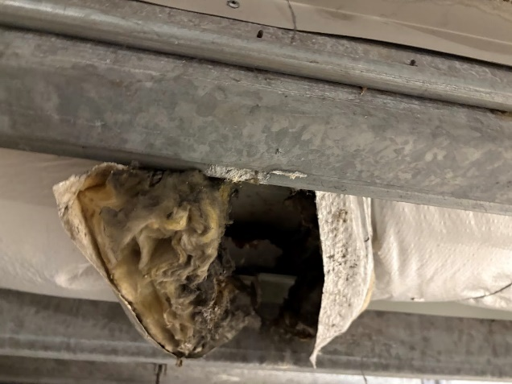
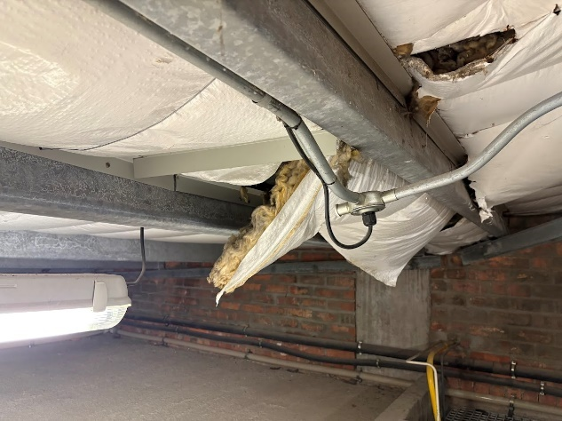
Khayelitsha Hospital
FINDINGS
2. Corrosion to roof sheeting
Presence of fibreglass insulation (Factorylite) directly abutting sheeting
Evidence of trapped moisture and debris buildup
Direct Contact with Insulation: Factorylite fibreglass insulation absorbed water; trapped moisture accelerates moulding, breakdown of protective coating and corrosion
Lack of vapour barrier or underlay: No separation between insulation and sheeting was observed, allowing condensation to collect and remain in contact with the underside of the sheeting. (subcontractor confirmed installation included an underlay.)
Water ingress causing moulding of roof insulation
Water damage to roof insulation

Slide 42
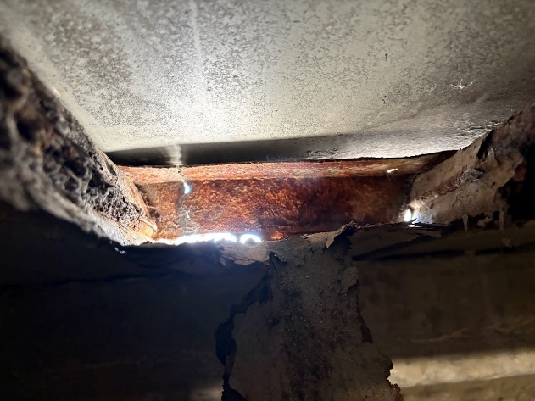
Khayelitsha Hospital
FINDINGS
2. Corrosion to roof sheeting
Poor Ventilation: Limited airflow beneath the roof plane has likely exacerbated moisture retention.
Coating Breakdown: Globalcoat corrosion protection failed under moisture exposure, possibly due to improper installation handling (cut edges, scratches).
Polyclosure strip failure causing wind-driven rain being pushed underneath flashing
Environmental Factors: Coastal humidity and airborne contaminants may have accelerated failure.
The extent of the corrosion appears to be localised but significant; further deterioration is expected.
Close-up of underside of sheeting and severe corrosion causing openings in flashing detail that promotes water ingress

Slide 43
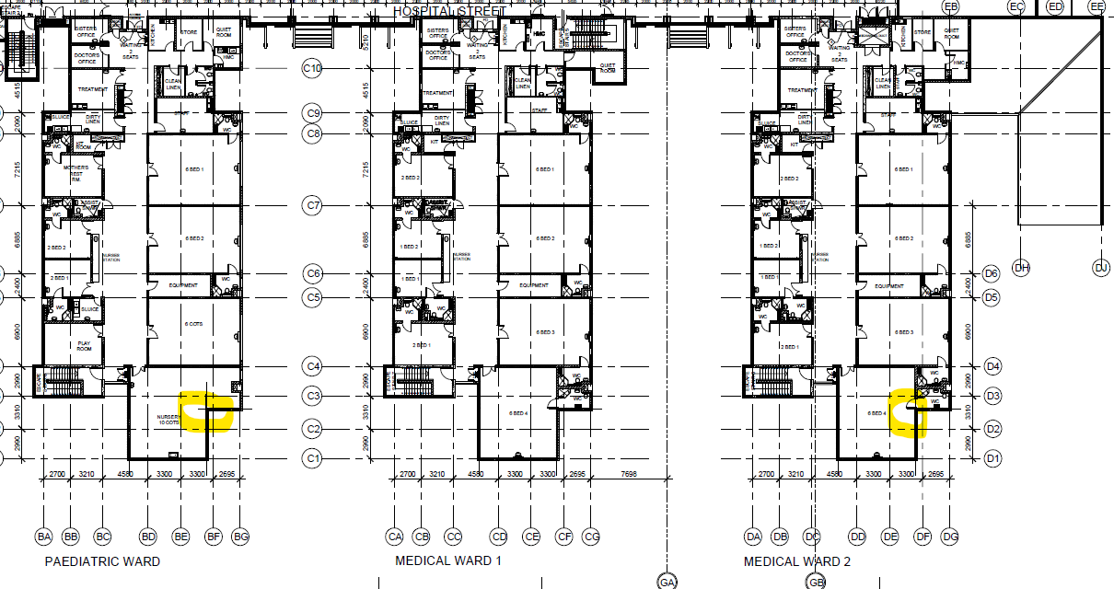

Khayelitsha Hospital
FINDINGS
3. Leaks to Ward Areas
Plan Second Floor Wards

Slide 44


Khayelitsha Hospital
FINDINGS
3. Leaks to Ward Areas
Damage to ceiling tiles: 6-bed patient wards at the southeast corner of the Paediatric and Medical 2 wards.
Position of leaks aligns with parapet wall that could contribute to the leak
Query if parapet wall constructed as per the intended typical detail
Possible cavity wall blocked
Possible flashing and counter flashing damage, potential replacement of flashings to be considered
Missing gutters along the northeastern facades
Ceiling damage to 6-bed ward
Typical Parapet Detail for Khayelitsha hospital

Slide 45


Khayelitsha Hospital
FINDINGS
3. Leaks to Ward Areas
External wall cracks previously reported could contribute to the leak
Roof sheeting could be corroding in this area, contributing to water ingress through the roof sheeting/flashing
Further investigations required to accurately determine the cause of the leaks in this area
Parapet Wall
Roof Void and parapet wall

Slide 46




Khayelitsha Hospital
FINDINGS
4. Presence of birds
Birds inhabit both the upper roof surfaces as well as the internal roof voids.
Bird droppings, which are corrosive, were observed in significant quantities both externally and internally.
Gaps within the roof coverings are visible, providing a clear space for birds to ingress into the roof void.
The volume of bird waste which is visible both above and below the roofs gives an indication of a lack of maintenance/cleaning within these areas.
Bird waste on top surfaces of roofs
Bird waste also visible on balconies
Large volumes of bird waste within roof void/service area
Clear gaps in roofs facilitating bird ingress

Slide 47




Khayelitsha Hospital
FINDINGS
5. Structural Observations
Minor wall cracks (≤3 mm) were observed at certain locations throughout the building. These appear to be typical settlement cracks and not structurally significant but may facilitate water ingress.
Despite the corrosion observed on the roof sheeting, no corrosion was observed on structural steel roof elements (purlins, rafters, etc,).
No damage was observed on timber roof elements, despite the limited presence of moisture in some areas.
Settlement cracks observed within the building
Steel roof elements in good condition
Timber roof elements in good condition
Moisture present on purlins near leaks, although the timber does not appear to be severely damaged

Slide 48
Khayelitsha Hospital
FACTORS CONTRIBUTING TO MOISTURE INGRESS
Design deficiencies of certain elements – evident within the roof consisting of a pitch transition, the relatively flat-sloped lower section of roof of 3° pitch that is exacerbating by driving rain being pushed underneath the apron flashing, and if the flashing is found to be of incompatible material, this further represents a major design oversight. (Though the subcontractor advised after the site inspection that dissimilar materials/metals have not been used.)
Poor workmanship – evident within “lap-en-pap” solution applied to the roof-pitch transition. It is suspected that roof sheeting was cut on-site with improper tools damaging integrity of the sheeting, causing corrosion to cut-edges.
Maintenance oversights – evident in the accumulation of bird waste present both on top of the roof as well as within the roof void.

Slide 49
Khayelitsha Hospital
RECOMMENDATIONS FOR KHAYELITSHA HOSPITAL
A comprehensive roof assessment to be undertaken by an independent roofing specialist to:
Assess full extent of corrosion
Assess risk to structural integrity of the sheeting and structural damage to clips.
Consider material testing to confirm corrosion depth to assist in determining severity of corrosion.
The rectification plan, prepared by the roofing specialist, depending on findings could entail:
Partial or full sheet replacement of roof sheeting and flashings
Replacement/retrofit of underlay or separation vapour barrier
Replacement of insulation
Improved roof cavity ventilation

Slide 50
Khayelitsha Hospital
RECOMMENDATIONS FOR KHAYELITSHA HOSPITAL
For roof replacement consider alternative roofing materials (taking the existing structural design and structural loading into consideration.)
If the replacement roof remains sheeting, due to the hospital’s relative proximity to the ocean the aluminium-zinc (AZ) coating can be increased from AZ 150 to AZ200 for additional sheeting protection. The higher AZ specification will have a cost implication but could beneficial if it has a longer guarantee period for the roof sheeting.
The roof design to be rationalised and simplified where possible.
If the structural roofing system allows eliminating the need for the apron roof pitch transition detail, as this is a weak spot in the roof, should be considered.
If the detail is still required, an improved adequate roof pitch transition/apron detail should be developed. Specific attention must be paid to minimising moisture retention, the suitability of materials in coastal areas, ensuring proper drainage, and eliminating the risk of bimetallic corrosion.

Slide 51
Khayelitsha Hospital
RECOMMENDATIONS FOR KHAYELITSHA HOSPITAL
Implement a bird control strategy to prevent nesting and the accumulation of bird waste in and around roofs. Close off all bird access points.
Implement a thorough cleaning and maintenance programme, which includes the removal of all debris and bird waste from roofs at regular intervals.
Replace missing gutters.
Although not structurally concerning at this stage, minor settlement cracks should be sealed to prevent water ingress, and their progression monitored over time.

Slide 52
Khayelitsha Hospital
LESSONS LEARNT
Avoid the implementation of similar roof pitch transitions/apron details.
Avoid overcomplicated roof designs.
Ensure that the roof pitch of at least 11 ° is selected in all future projects to reduce the risk of wind-driven moisture ingress.
Ensure roof designs comply with latest SANS 10400, especially consider Parts L, R, T, XA.
Assess subcontractor’s previous installation experience and workmanship.
Inspections during construction: It is imperative that detailed inspections by PSP and manufacturer take place during and after installation, to assess if roof sheeting, edges and flashings are not damaged/deformed. Replacement of damaged material is required and repairs should not be permitted.
Use of an approved vapour control membrane or underlay is required, to protect roof installation from moisture damage.

Slide 53
Khayelitsha Hospital
LESSONS LEARNT
Long span sheeting to be considered to avoid cutting/joints.
Avoid on-site cutting of roof sheeting and flashings (cutting off-site at factory)
If on-site cutting is required, manufacturer approved cutting methods and tools such as nibblers, hand shears/tin snips that preserve the protective coating and structural integrity of the sheeting should be employed.
Avoid cutting over installed roofs.
All metal filings/ swarf to be removed after cutting to avoid corrosion.
Avoid use of cutting tools with abrasive discs angle grinders or tools that generate heat/sparks.
Investigate the specification of a more robust roof sheeting in future projects. The suitability of AZ200 could be investigated as a potential replacement sheet specification, though this will have a cost implication.

Slide 54
Design Quality Oversight – A Building Systems Approach _ Roof Systems
CLOSING COMMENTS AND TEAM FEEDBACK CHANNELS
CONTACT PPID ARCHSERVICES
DOI-CDHI.PPID-ARCHSERVICES@westerncape.gov.za
CHIEF ARCHITECT FOR YOUR TEAM
Metro 1 | Metro 2 (GKO) | Metro 3 (WCW) | Metro 4 (METRO WEST)
Cornelia Mc Enery - Hayes | Vongai Pasirayi | James Claassen | Karl – Robert Gloek

